Slide 1
Matter & Energy Jeopardy

Slide 2
Rules
How are you playing?
With a Partner
With the Class

Slide 3
Scales & Balances
Basic Terms
States of Matter
Metric & Standard
How Things Work
100
100
100
100
100
200
200
200
200
200
300
300
300
300
300
400
400
400
400
400
500
500
500
500
500
600
600
600
600
600

Slide 4
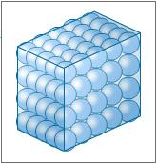
What are the molecules in a solid?

Slide 5
It is the amount of matter in objects and substances.
What is mass?

Slide 7
Car exhaust, oxygen, and water vapor are examples of this.
What is a gas?

Slide 8
38 cm, 67 mL, and 12 kg are examples of this.
What is metric measurement?

Slide 9
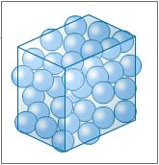
What are the molecules in a liquid?

Slide 10
Water, milk, and orange juice are examples of this.
What is a liquid?

Slide 11
It is a substance that has a definite shape and volume.
What is a solid?

Slide 12
It is a substance that has a definite volume but no definite shape.
What is a liquid?

Slide 13
It is a substance that has no definite shape or volume.
What is a gas?

Slide 14
It is the measure of how much space an object or substance takes up.
What is volume?

Slide 15
Anything that has mass and takes up space.
What is matter?

Slide 16
It is light that is bouncing off of an object or surface.
What is reflection?

Slide 17
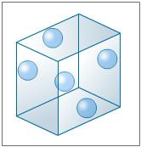
What are the molecules in a gas?

Slide 19
It what is needed to be able to see an object.
What is light?

Slide 20
It what is happening so that you can see an object.
What is light reflecting off of an object?

Slide 21
It is the main source of light energy on Earth.
What is the sun?

Slide 23
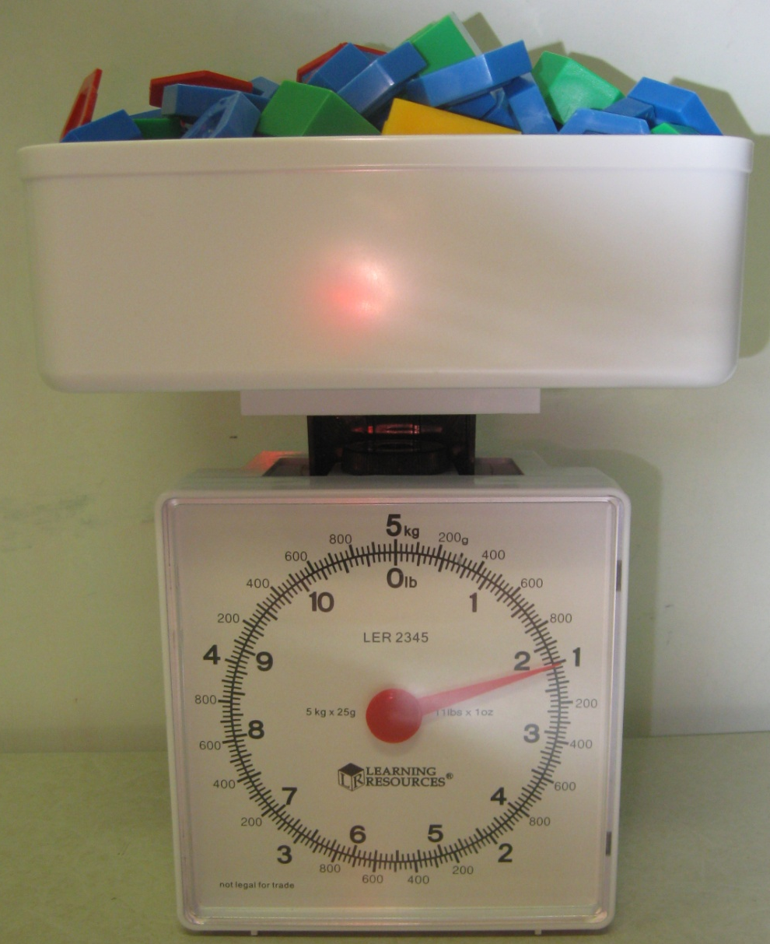
What is 1 kg or 1000g?

Slide 25
What is 700g?

Slide 26
What is a pan balance?

Slide 27
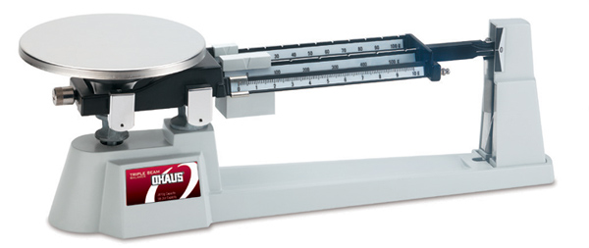
What is a beam balance?

Slide 28
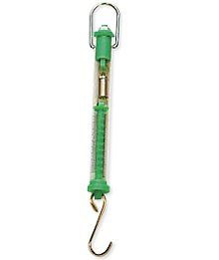
What is a spring scale?

Slide 29
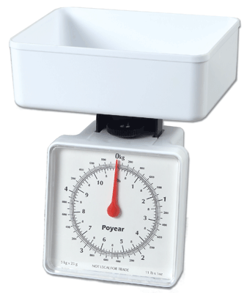
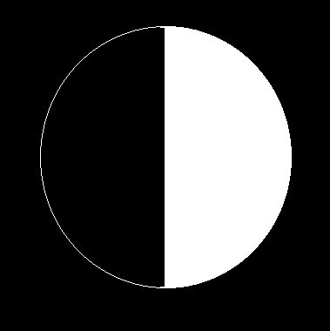
What is a platform scale?

Slide 30
It is what caused the food coloring to travel all throughout the water in our experiment.
What is the movement of water molecules?

Slide 31
The way light travels.
What is in a straight line?

Slide 33
46 in, 79 lbs, and 81 gal are examples of this.
What is standard/imperial measurement?

Slide 34
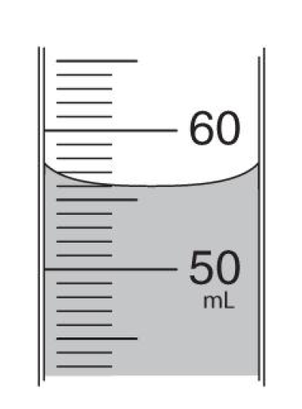
What is 56 mL?

Slide 37
What is the standard/imperial side of a ruler?

Slide 38
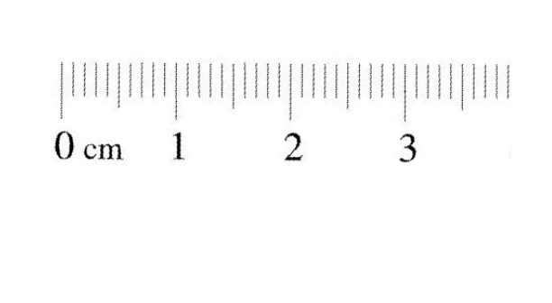
What is metric side of a ruler?

Slide 42
Ice, chairs, and apples are examples of this.
What is a solid?

Slide 43
It is energy.
What is needed to change a solid to a liquid to a gas?

Slide 53
With a Partner
The shorter person picks the first category and point value.
Click on the selected category and value.
Both partners answer the statement with a question.
Partners write the answer on their whiteboard.
Click again to get the answer.
Whoever is correct gets the points for the answer.
Write the points and category on a separate paper for each person who got the answer correct.
Click on the blue box in the lower right corner to get back to the main board.
Take turns picking the category and point value.
Continue until all categories and values are taken.
The person with the most points at the end wins.

Slide 54
With the Class
The shorter person from the class picks the first category and point value.
Click on the selected category and value.
Groups get in order from shortest to tallest.
The shortest person in each group will be the first to answer the question.
The person up in each group will answer the statement with a question.
The person who is up in each group write the answer on their whiteboard.
Click again to get the answer.
Whoever is correct gets the points for the answer.
Write the points and category on the board for each team who gets it correct.
Click on the blue box in the lower right corner to get back to the main board.
Go from right to left from teams picking the category and point value.
Continue until all categories and values are taken.
The group with the most points at the end wins.

