Slide 1
Classification Jeopardy

Slide 2
Rules
How are you playing?
With a Partner
With the Class

Slide 3
Other Activities
Terms for Classifying
Plant Terms
Types of Animals
Classifying Vertebrates
Differences in Vertebrates
100
100
100
100
100
100
200
200
200
200
200
200
300
300
300
300
300
300
400
400
400
400
400
400
500
500
500
500
500
500
600
600
600
600
600
600
700
700
700
700
700
700
800
800
800
800
800
800

Slide 4
A plant that does not have tubes.
What is a nonvascular plant?

Slide 5
The second smallest name grouping used in classification.
What is genus?

Slide 6
They are both living, both need water, and both need food.
What are similarities between plants and animals?

Slide 7
The part that holds the plant up.
What is the stem?

Slide 8
A vertebrate animal that has feathers and wings.
What is a bird?

Slide 9
A plant that has tubes.
What is a vascular plant?

Slide 10
The underground part of the plant that anchors it and may store food.
What are the roots?

Slide 11
The largest group into which living things can be classified.
What is a kingdom?

Slide 12
A kingdom of living things that can move, must find food, and respond to things.
What is animal?

Slide 13
A kingdom of living things that makes its own food.
What is plant?

Slide 14
The smallest name grouping used in classification.
What is species?

Slide 15
The grouping of things using a set of rules.
What is classification?

Slide 16
The names of the five kingdoms.
What are animals, plants, fungi, protists, and monerans?

Slide 17
The process where plants make food using sunlight.
What is photosynthesis?

Slide 18
The way that scientists classify things into different groups.
What is by similarities?

Slide 19
It takes 365 ¼ Earth days.
How long does it take for the Earth to orbit the sun?

Slide 20
They are two thing that a human can be classified as.
What are a living thing, an animal, a vertebrate, and a mammal?

Slide 21
A catfish is this kind of vertebrate.
What is a fish?

Slide 22
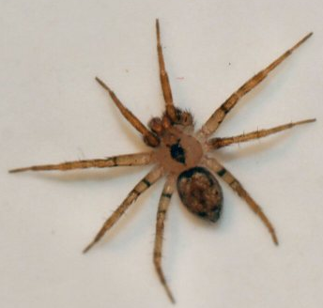
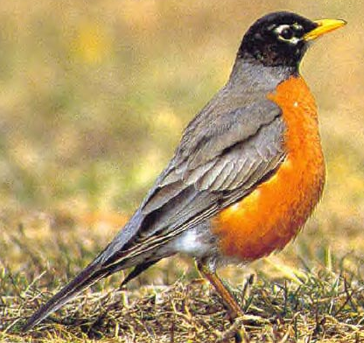
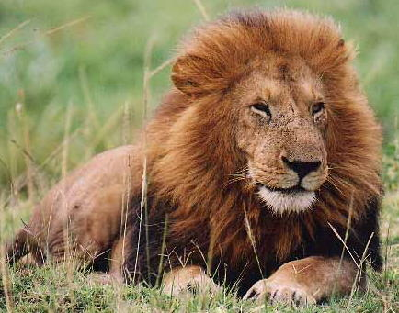
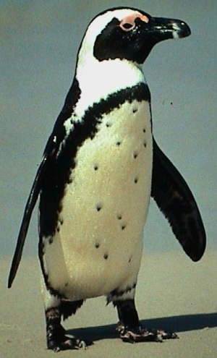
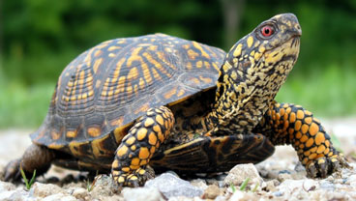
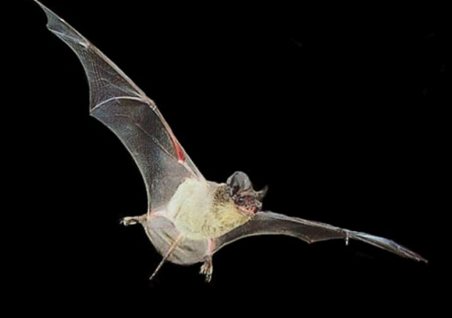
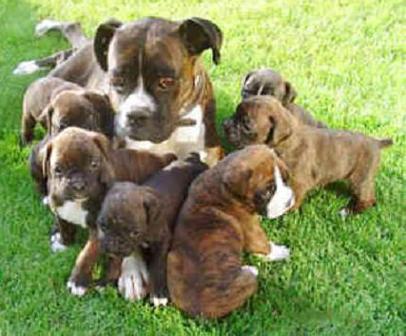
These are the categories below.
What are things with eggs/without live young and things without eggs/with live young?

Slide 23
Using the website, identify the tree.
What is a White Oak?

Slide 24
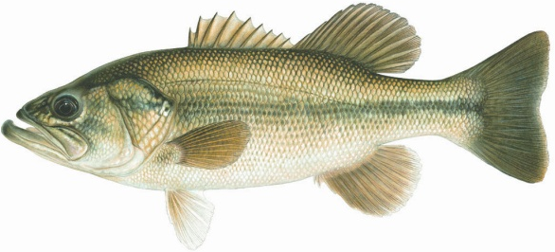
These are the categories below.
What are things that swim and things that don’t swim?

Slide 25
These are the categories below.
What are things with wings and things without wings?

Slide 26
Using the website, identify the tree.
What is a Tamarack?

Slide 27
Using the website, identify the tree.
What is a Black Ash?

Slide 28
Using the website, identify the tree.
What is a Balsam Fir?

Slide 29
Using the website, identify the tree.
What is a Jack Pine?

Slide 30
A lion is an example of this type of vertebrate.
What is a mammal?

Slide 31
A snake is this type of vertebrate.
What is a reptile?

Slide 32
They are two thing that a turtle can be classified as.
What are a living thing, an animal, a vertebrate, and a reptile?

Slide 33
A vertebrate animal that lives in water its whole life.
What is a fish?

Slide 34
An animal that has hair and produces milk for its young.
What is a mammal?

Slide 35
It is the 3rd planet from the sun.
What is Earth?

Slide 36
An animal that has dry, scaly skin.
What is a reptile?

Slide 37
An animal that has moist skin and no scales.
What is an amphibian?

Slide 38
An animal with a backbone.
What is a vertebrate?

Slide 39
An animal without a backbone.
What is an invertebrate?

Slide 40
An animal that keeps the same temperature as what is around it and an animal whose body temperature doesn’t change very much (The answers must be in the correct order).
What are cold-blooded and warm-blooded?

Slide 41
They are two thing that a clam can be classified as.
What are a living thing, an animal, an invertebrate, and a mollusk?

Slide 42
The food making part of the plant.
What are the leaves?

Slide 43
An eagle is this type of vertebrate.
What is a bird?

Slide 44
Plants make their own food and animals find their food.
What is a major difference between plants and animals?

Slide 45
The organ that fish use to get oxygen from the water and remove carbon dioxide.
What are gills?

Slide 46
This is the animal that breathes different from all other vertebrates.
What is a fish?

Slide 47
The type of vertebrate that lives in the water when it is young and lives on land when they have fully developed.
What is an amphibian?

Slide 48
This is the kind of vertebrate that has young in a different way than any other and it is they way they have young.
What is a mammal and by live birth?

Slide 49
This is the body covering that mammals have to protect their body.
What is fur?

Slide 50
These are the vertebrates that care for their young.
What are mammals and birds?

Slide 51
These are the ways that mammals move.
What is by walking, swimming, and flying?

Slide 52
These are the ways that birds move.
What is by using legs (walking/hopping) and wings (flying)?

Slide 53
With a Partner
The shorter person picks the first category and point value.
Click on the selected category and value.
Both partners answer the statement with a question.
Partners write the answer on their whiteboard.
Click again to get the answer.
Whoever is correct gets the points for the answer.
Write the points and category on a separate paper for each person who got the answer correct.
Click on the blue box in the lower right corner to get back to the main board.
Take turns picking the category and point value.
Continue until all categories and values are taken.
The person with the most points at the end wins.

Slide 54
With the Class
The shorter person from the class picks the first category and point value.
Click on the selected category and value.
Groups get in order from shortest to tallest.
The shortest person in each group will be the first to answer the question.
The person up in each group will answer the statement with a question.
The person who is up in each group write the answer on their whiteboard.
Click again to get the answer.
Whoever is correct gets the points for the answer.
Write the points and category on the board for each team who gets it correct.
Click on the blue box in the lower right corner to get back to the main board.
Go from right to left from teams picking the category and point value.
Continue until all categories and values are taken.
The group with the most points at the end wins.

